Slide 1
Mitigation Measures in Agriculture
Innovative technologies for climate change mitigation by Mediterranean agricultural sector– Clima MED
LIFE17 CCM/GR/000087
https://life-climamed.eu/home

Slide 2
Mitigation Measures
Mitigation measures for climate change are actions and strategies aimed at reducing or preventing the emissions of greenhouse gases and other factors that contribute to global warming and its associated impacts. These measures are essential to limit the extent of climate change and its negative effects
The philosophy behind mitigation measures for climate change is rooted in the recognition of humanity's responsibility to address the environmental consequences of its actions and to safeguard the well-being of current and future generations. This philosophy is built on five key types of mitigation.

Slide 3
The five key types of mitigation
Avoidance: this strategy involves making conscious choices to prevent emissions e.g. project type, location etc.
Minimization: practices aimed at minimizing the negative environmental impacts associated with agricultural activities. Focuses focus on reducing resource use, pollution, and other adverse effects while maintaining or improving productivity
Restoration: practices aiming at repairing or rehabilitating ecosystems, landscapes, or agricultural practices in a way that contributes to climate change mitigation e.g. restoration of degraded lands, soil health improvement, carbon sequestration enhancement etc.
Adaptation: strategies aimed at adjusting systems and practices to the changing climate in order to minimize negative impacts and enhance resilience e.g. drought resistant crops, flood management strategies etc.
Compensatory: practices aimed at compensating for emissions through activities that remove or reduce an equivalent amount of greenhouse gases from the atmosphere e.g. agroforestry, renewable energy, tree planting etc.

Slide 4
Risk Mitigation Plan
Identify Risks
Assess the Risks
Develop Management Strategies
Create your Plan
Develop a Contingency Plan
Monitor
Risk events and their relationship are defined
Evaluate each identified risk in terms of its likelihood and potential impact
Prioritize the risks based on their significance
For each high-priority risk, develop specific strategies to mitigate or minimize its impact
Set timelines and deadlines for when each mitigation strategy should be implemented
Strategies could include actions to avoid the risk, reduce its likelihood, or lessen its consequences
Assign responsibilities and determine the resources required to implement the mitigation strategies
Used to address the risks that have already occurred
Helps minimize the negative impact on the project
Systematically tracking the progress, effectiveness, and outcomes of your mitigation strategies
Make informed adjustments, and ensure that your plan remains on track.
List all the potential risks

Slide 5
Why mitigation in agriculture?
Agriculture, Forestry and Land Use directly accounts for 18.4% of greenhouse gas emissions equivalent to 8.9 Gto of CO₂ eq.and is divided as such:
Cropland (1.4%): agriculture management practices affect the lost or sequestration of carbon in soils. The balance in changing carbon stock is captured as carbon dioxide emissions.
Deforestation (2.2%): Emissions reflect on the carbon stock loss from forest and forest soils.
Crop Burning (3.5%): Burning of agricultural leftovers releases carbon dioxide, methane and nitrous oxide

Slide 6
Why mitigation in agriculture?
Rice Cultivation (1.3%): flooded paddy fields create anaerobic conditions that convert organic matter into methane
Agricultural soils (4.1%): A part of nitrogen fertilizers is released to the air as nitrous oxide – a greenhouse gas
Livestock and manure (5.8%): Animals, mainly cattle produce methane as a result of their enteric fermentation

Slide 7
Mitigation Measures
 | CO₂ | CH₄ | N₂O
Antimethanogenic agents (ruminants) |  | ✓
Increase of productivity (livestock) | ✓ | ✓ | ✓
Improved efficiency of nitrogen fertilizers |  |  | ✓
Building soil organic matter | ✓ | ✓ | ✓
Soil Carbon Sequestration | ✓
Perennial crops | ✓
Land Management | ✓
Food Loss Reduction | ✓ | ✓ | ✓
Renewable Energy | ✓ | ✓
Climate Smart Agriculture | ✓ |  | ✓

Slide 8
Adaptation Vs Mitigation measures
Adaptation | Mitigation
Prevent or minimize the adverse effect of climate change | Reduce or prevent GHG emissions to mitigate the climate change effect
Designed to reduced vulnerability of local communities and ecosystems | Designed to promote carbon sequestration and avoid the increase of pollutant emissions
Does not tackle the source of the problem | Tries to tackle the problem at the source
Focused on managing climatic risks | Focused on Reducing Emissions
Short-to-medium-term Focus | Long term focus

Slide 9
Livestock system transition
Livestock is the largest contributor of non-CO2 greenhouse gases
CO₂: 80%
CH₄: 60-70%
Mitigation Measures
The first strategy group includes supplementation with anti-methanogenic agents. Methane production in ruminants is considered efficiency loss. Strategies that reduce methane emissions can also benefit energy efficiency by preventing metabolic diseases and increasing production. A variety of nutritional supplements serve this purpose with varying effectiveness:
Chemical inhibitors (33-91%),
Electron receptors (16-30%) or
Dietary lipids (5-40%)

Slide 10
Livestock system transition
The second group of strategies has to do with increased livestock production efficiency and improved resource use. According to Food Agriculture Organization (FAO) the available husbandry practices can reduce livestock emissions by 20-30%.
A balanced combination of indoor housing and grazing can lead to a 22% reduction in CO₂ and improve animal welfare
  Care is required to avoid the spread of disease and stress
  Reducing social stress in ruminants and pigs can improve their feed efficiency
Proper record keeping of animal performance, health and breeding history can identify areas of improvement and inform decision making on breeding the next farm generation.

Slide 11
Livestock system transition
Providing good standards of livestock health by reducing the impact of diseases and parasites, can increase the average productive life span of animals, avoid milk reduction from diseases such as mastitis, thus reducing GHG per kg or liter of product.
Other practices include the improvement of:
  the average fertility rate of the herd,
  Reduction of the interval between births (5-10% birth rate increase),
  Reduction of the age at first calving (8-10% GHG reduction) and
  Extent of the reproductive life of the animal.
  Selective breeding for increased productivity and feed efficiency can reduce GHG emissions up to 15%, but severe effect on health, welfare and fertility is prominent.

Slide 12
Improved efficiency of nitrogen fertilizers
Nitrogen applications are preferred to be aligned with crop demands
Measurement of soil N content before application to accurately determine needs
Recommended rates should not be exceeded
Application in smaller doses is more effective than single application
Nitrogen fertilizer applications should be postponed when the soil is saturated and at high temperatures
Fertilizers coated with slow-release substances or nitrification inhibitors can reduce nitrate degradation and ammonium volatilization

Slide 13
Building soil organic matter
Soil organic matter contains 58% carbon. The rest is oxygen, hydrogen and nutrients
Organic matter enhances soil fertility through increased water infiltration, nutrient retention and supports microbial activity
Ways to increase organic matter
Cover crops or off-season high biomass crops
Incorporation of crop residues
Crops with high density or deep roots
Adding organic amendments such as peat, wood chips, grass clippings, straw, compost and manure
In order to conserve organic matter, the practice of reduced tillage is recommended

Slide 14
Soil carbon sequestration
Agricultural activity has the potential to offset carbon emissions through carbon sequestration. Soil play a key role in mitigating climate change as it can be a potential sink of atmospheric carbon dioxide with the additional benefit of increasing soil fertility.
The term ‘carbon farming’ refers to practices that boost carbon the uptake and store of carbon in soil. Current effective management methods include:
notably reducing tillage intensity,
eliminating summer fallow,
planting more forages, and
increasing residue inputs from higher yields.

Slide 15
Soil carbon sequestration
Grassland are estimated to contain nearly 50% more carbon than forests. Converting cropland to permanent grasslands or fallow can result in significant increase in soil C sequestration. Further, rotational grazing can stimulate the growth of perennial grasses effectively increasing the carbon stock. For degraded grasslands, temporal and spatial management of livestock, fertilization and introduction of new plant (e.g. legumes) can help to restore them. Agroforestry and agropastoral system also has an important carbon sequestration potential, as it stores carbon in soil and as biomass in trees.
Weather conditions can influence the SOC balance of soil. Drought periods usually slow down the gains of C, that is slightly compensated from the reduced decomposition rate. Contrastingly, wet conditions increase C gains as the C inputs are slightly higher than the increased decomposition rate.

Slide 16
Factors affecting soil carbon pool capacity
Soil Organic Carbon
Climate
Precipitation, Extreme Events, Growing Season
Soil
Texture, Structure, Mineralogy, Water retention
Vegetation
Canopy cover,
Species composition, Root system
Terrain
Slope, Length, Landscape position, Drainage density

Slide 17
Perennial crops
Perennial crops are considered permanent crops and have a life cycle of at least three years. They don’t need to replanted every year and usually require few grow cycles before fruits (apples, coffee, walnuts etc.) or they can regrow after harvesting (e.g. taro, cranberries, asparagus, oilseed crops etc.).
Compared to annual crops they have larger root system that prevents soil erosion, retains water, improves soil structure and enhance fauna biodiversity. They can significantly increase biomass yield and yield stability compared to continuous annual crops. Regarding carbon sequestration, they can efficiently store carbon in the soil and as plant biomass.
The development of diverse perennial grain agriculture has the potential to restore many pre-existing ecosystem services. Also it strengthens farmers resilience by providing diverse income and avoiding the costly yearly expenses and operational effort of establishing new crops.

Slide 18
Land management
Effective land management has the potential to effectively reduce, prevent or even reverse the environmental impact.
Agriculture and livestock expansion, especially in Latin America, results in land conversion of forests into agricultural land, significantly reducing biomass and soil carbon stock. Avoiding conversion of high carbon landscapes (e.g. forest, wetlands) is the first step in preventing further land degradation.
Afforestation is the process of introducing new trees to an area that had no trees before and reforestation is the practice of tree planting to an area with decreasing number of trees. Both can restore degraded land and natural ecosystems, sequestrate carbon and offset GHG emissions. However, it is essential to consider that for a successful establishment of forests, selection of tree species adapted to regional climate and community engagement are essential.

Slide 19
Land Management - Regenerative agriculture
Regenerative agriculture can rehabilitate degraded lands and convert them into healthy ecosystems to promote carbon sequestration and biodiversity.
The ultimate goal of regenerative agriculture is to create productive and self-sustaining agricultural systems that benefit both the environment and the communities they support.
Regenerative agriculture recognizes the complexity of air, water and soil interactions, and that agriculture must also give back to the system, establishing cycles of regeneration. The main principles include:
  soil heath improvement
  no-till or reduced tillage
  water management and
  biodiversity conservation.
Some of the farming practices include rotating grazing, agroforestry, use of compost and cover crops.

Slide 20
Food loss and waste reduction
Food loss and waste accounts for 8-10% of global greenhouse gasses and a huge waste of natural resources and energy. Reducing food waste along the supply chain can reduce the environmental impact of agriculture and help combat malnutrition.
When food is wasted farmers fleet to intensive farming practices that often involve heavy use of fertilizers and pesticides, to compensate for the wasted food.
By cutting down food waste, farmers can move towards more sustainable practices, preserving water and protecting of non-renewable resources.
Pressure on biodiversity and natural habitats is alleviated, as the need for agricultural expansion to meet the increasing food demands is prevented. Conversion of forest into cropland can also be reduced, safeguarding the natural carbon stocks and preserving the ability of forest to capture carbon dioxide.

Slide 21
Energy Use per Input Component
The main energy uses are for agriculture operations in the field, agricultural inputs, machinery use, irrigation, transportation, and on-farm postharvest operations (storage, drying etc.).

Slide 22
Energy use
Agriculture and forestry sector consumes about 3.7% of the total energy in the EU
Nitrogen fertilizer production alone, accounts for about 48% of energy used in primary production.
Machinery use is responsible for about 30% of the agricultural energy use
It is important to use tractors and machinery fit for purpose to avoid inefficient consumption of fossil fuel. Diesel engine used in mechanical pumping can be replaced with solar powered irrigation pumps.

Slide 23
Energy use
Implementing renewable energy technologies on farms, such as solar panels or wind turbines, to meet energy needs can greatly reduce the reliance of agricultural sector on fossil fuels.
Methane recovery from manure is a practice that can be easily used in large livestock units. Methane can be captured from manure storage facilities and use it for biogas, a renewable energy source. This also reduces methane emissions reducing the substantial environmental impact of livestock production.

Slide 24
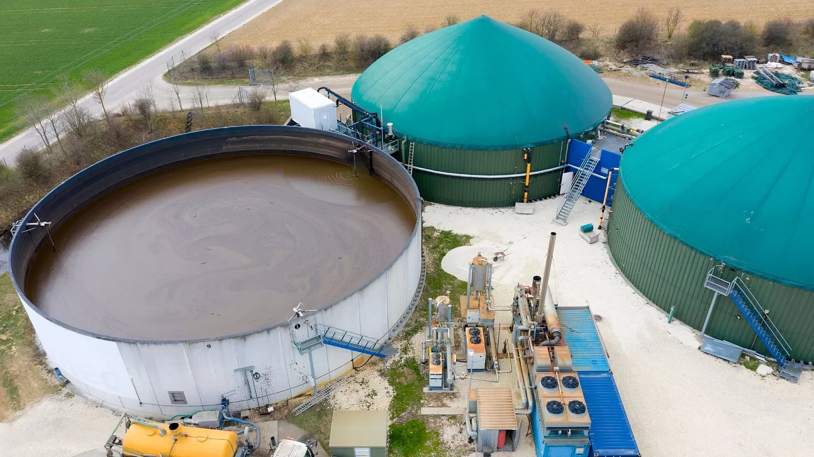
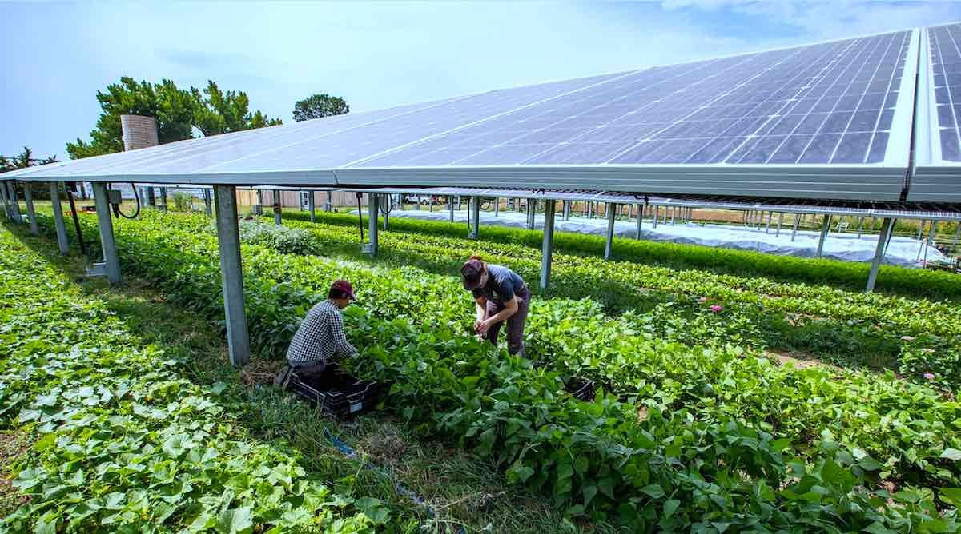
Energy use
Biogas Production | Agrivoltaics
Biogas is produces under anaerobic condition where microorganisms break down organic matter (manure) producing methane, CO₂ and small quantities of other gasses. | Combines crop production with solar energy in a way that benefits the performance of both. Solar panels protect the crops located underneath (high temperatures, hailstone etc.) and reduce evapotranspiration, thus reducing water footprint. In return the efficiency of photovoltaics can increase almost 2-fold.

Slide 25
Climate-smart agriculture
Climate smart agriculture (CSA) practices are strategies that aim to increase productivity and enhance resilience towards a green and climate resilient farming.
CSA is a way of combining the sustainable practices to tackle a specific climate risk , tailored for an established farming community. Farmers are equipped with the knowledge required to implement sustainable practices that fit the problem at hand.
For example, farmers located in areas with long drought periods can improve water retention and infiltration soil ability by increasing soil organic matter, planting cover crops (e.g. vetch and cereals) or applying biodegraded films on top of the soil.

Slide 26
Climate-smart agriculture
CSA strategies provide the essential information to farmer on what to apply and when to avoid excess application of pesticides. Pest and disease resistant crop varieties are constantly being developed. Planting those varieties can eliminate or significantly reduce pesticide application.
Examples related to the Mediterranean include:
Potato and tomato varieties resistant to nematode or downy mildew
Inoculation of watermelon in pumpkin to take advantage of the resistance of pumpkin to soil-borne diseases, e.g. Fusarium and better absorption of water and nutrients

Slide 27
Agricultural solid waste management
Reduce
Reuse
Recycle
Proper storage and handling
integrated pest management to reduce chemical use,
adopting precision agriculture techniques, and
optimizing fertilizer application
Reuse of containers and packaging materials when possible
Minimize waste generation using:
Crop residues, livestock manure, and other organic waste can be used to produce biogas/ biofuel, compost and nutrient-rich slurry
Recycle certain waste materials, such as plastic containers
Disposal
Collect and properly dispose of non-biodegradable waste, such as plastic mulch and pesticide containers, to prevent environmental contamination

Slide 28
Water Management in Agriculture
Water management practices that can help conserve water resources:
Efficient Irrigation
  Installation of irrigation systems that minimize losses e.g. drip irrigation
  Schedule irrigations using sensors to irrigate when plants actually need water
  Prefer to irrigate during night hours when there is less evaporation
  Make irrigation plans based on the soil – climatic conditions of the area and the crop
  Proper soil system maintenance
Crop Selection
  Choose crops that are well-suited to the local climate and water availability
  Selection of drought-resistant varieties or crops that complete the crop cycle in a shorter period
  Crop selection considering rainfall, available irrigation water and crop yield

Slide 29
Water Management in Agriculture
Mulching
  Apply organic or synthetic mulch around plants to reduce evaporation, maintain soil moisture, and suppress weed growth
Soil Management
  Improve soil structure and water-holding capacity and avoid soil compaction
Wastewater Use
  Use of treated wastewater too conserve freshwater resources. Treated wastewater also contain nitrogen and phosphorous, important elements for plant growth
Rainwater Harvesting
  Collect and store rainwater for irrigation during dry periods using tanks or ponds. Easier to apply in greenhouses where they cover a lot of surface and have water drainage system
Smart Technology
  Utilize technology like remote sensing, soil moisture monitoring, and precision irrigation systems to optimize water use.

